Slide 1
Java SE Developer 1z0-819
講師:江聖榮

Slide 2
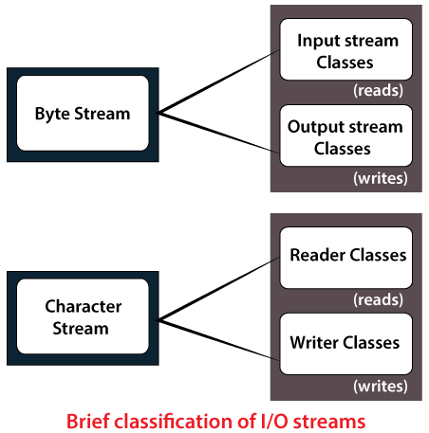
Java.io.*
File
純文字
Reader
Writer
資料流stream
OutputStream
InputStream

Slide 3
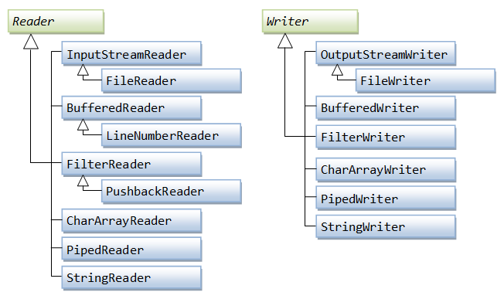
純文字檔
Writer
FileWriter
內容已包括File
Reader
FileReader

Slide 4
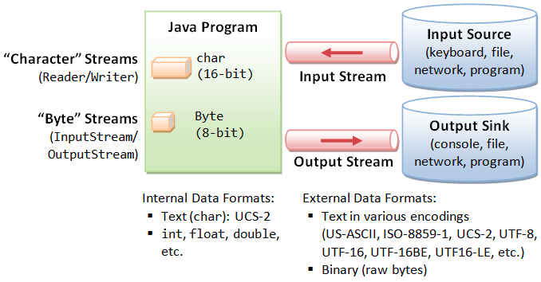
Stream資料流-串接應用
OutputStream
FileOutputStream
OutputStreamWriter
BufferedWriter
InputStream
FileInputstream
inputStreamReader
BufferedRReader

Slide 5
與物件導向結合
ObjectOutputStream
ObjectInputStream
Student
-name:String; -chi:int; -eng:int; -sum:int;
+Student(名,國文,英文);
+show():void;//名,國文,英文,總分

